Slide 1
Team Shi
SudokuPlus

Slide 2
Team Members:
Mitchell Baer – Logic/Unit Testing
Matt Dean-Hall - GUI
Eric Celerin – Server/User Thread/GUI

Slide 3
Sprint 1:

Slide 4
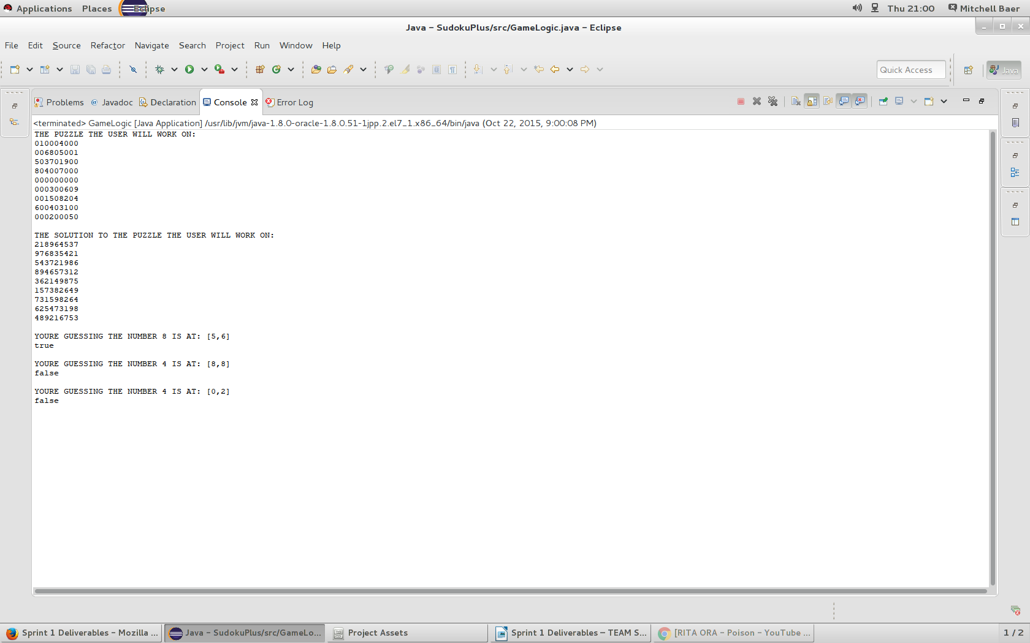

Slide 5
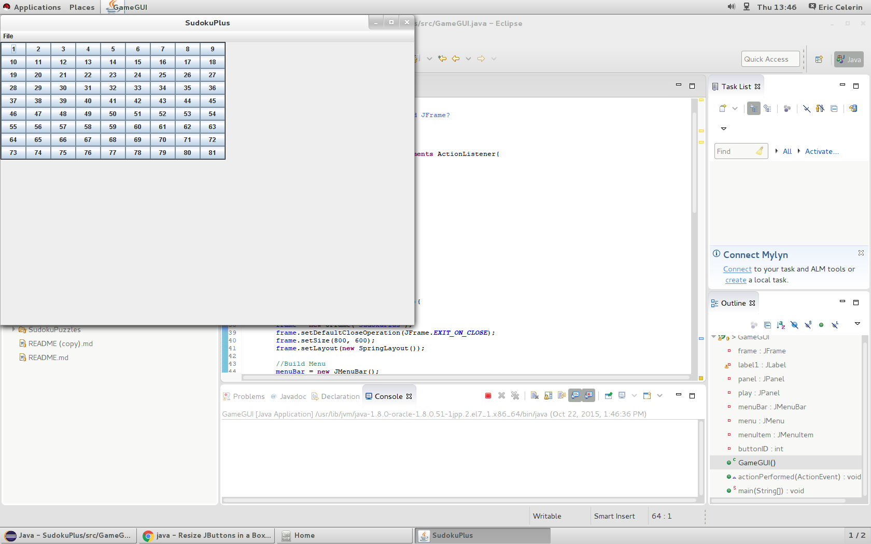

Slide 7
Sprint 2:

Slide 8
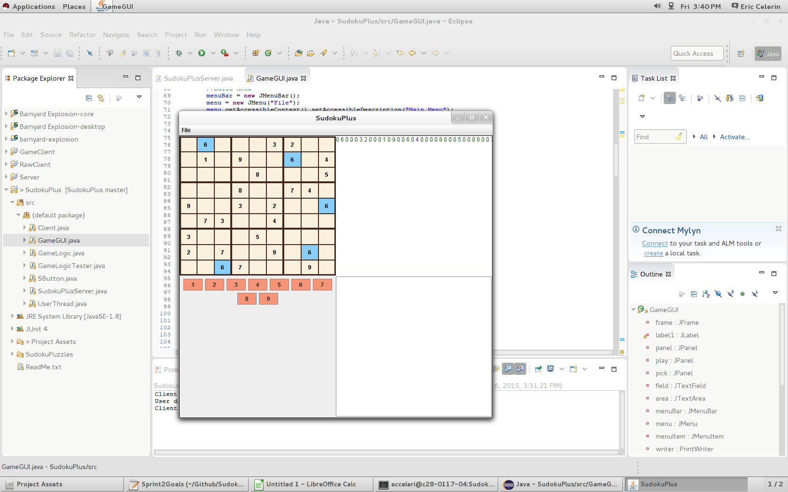

Slide 9
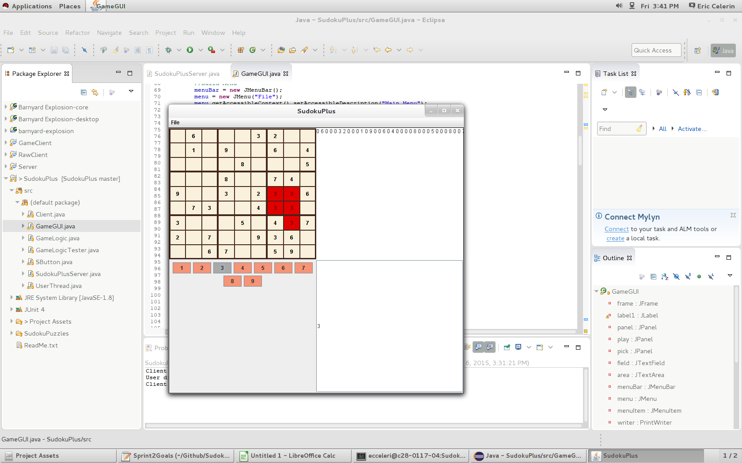

Slide 10
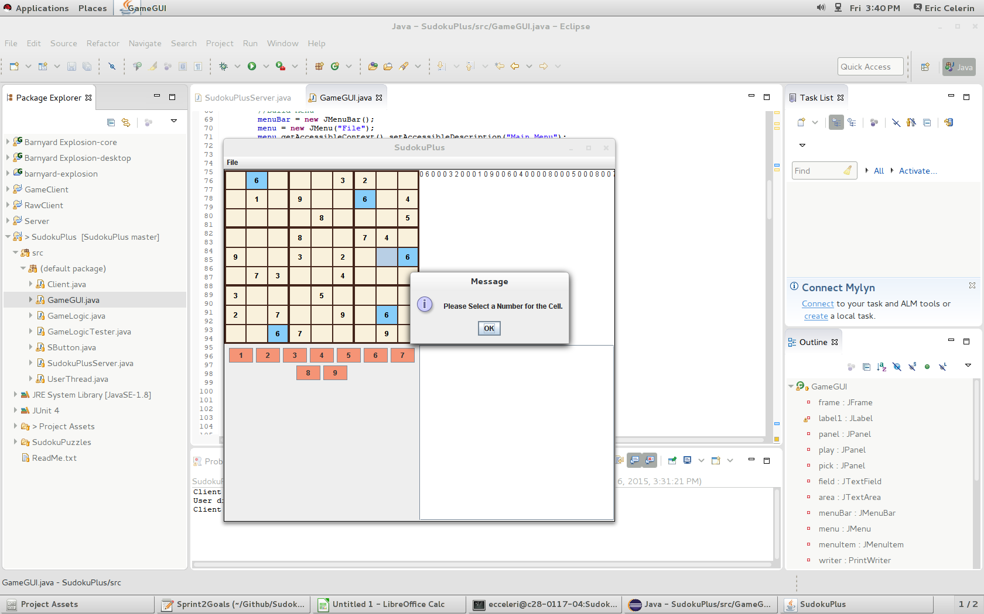

Slide 11
Unit Tests (JUnit)

Slide 12
Sprint 3:

Slide 13
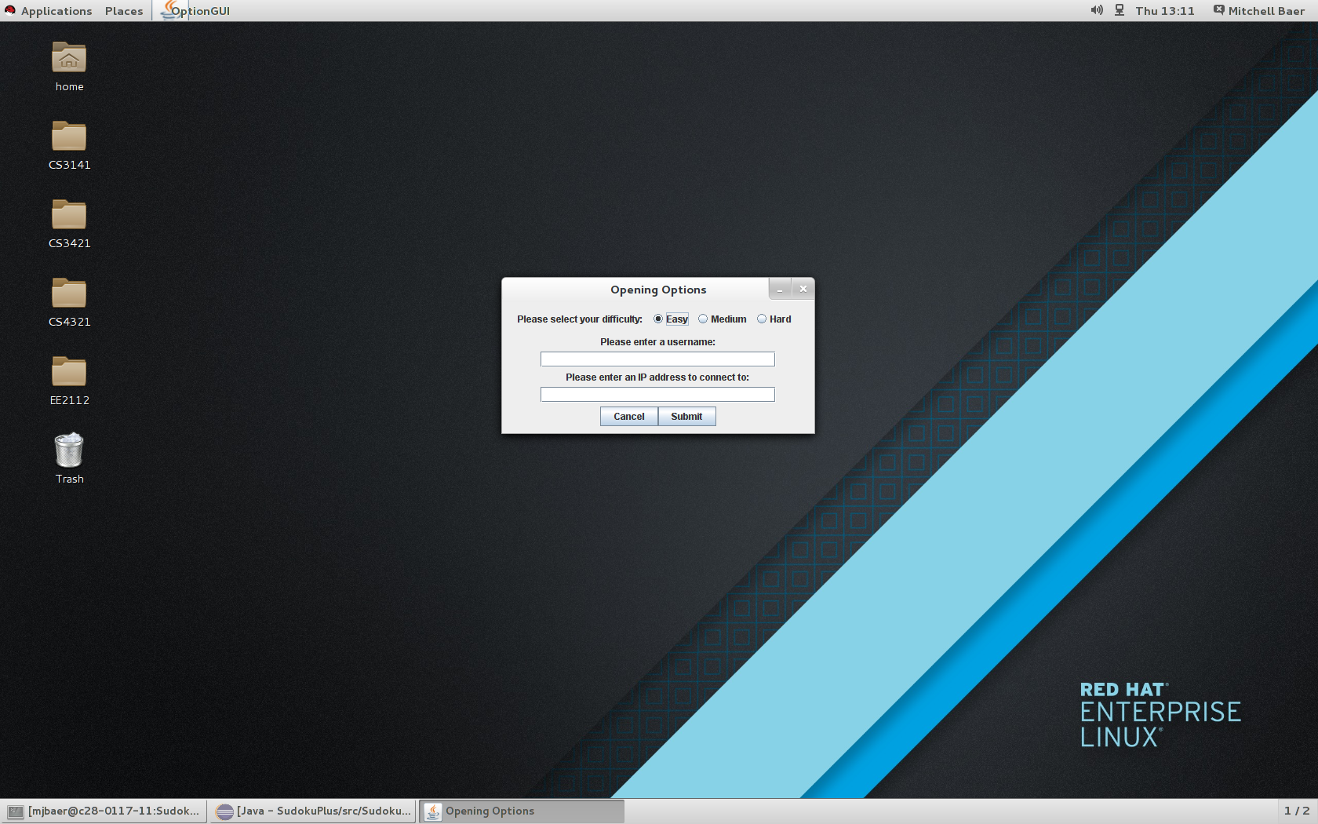

Slide 14
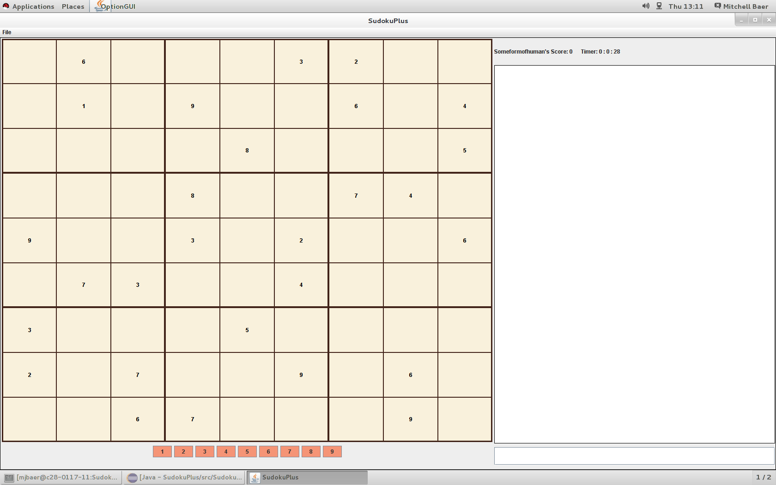

Slide 15
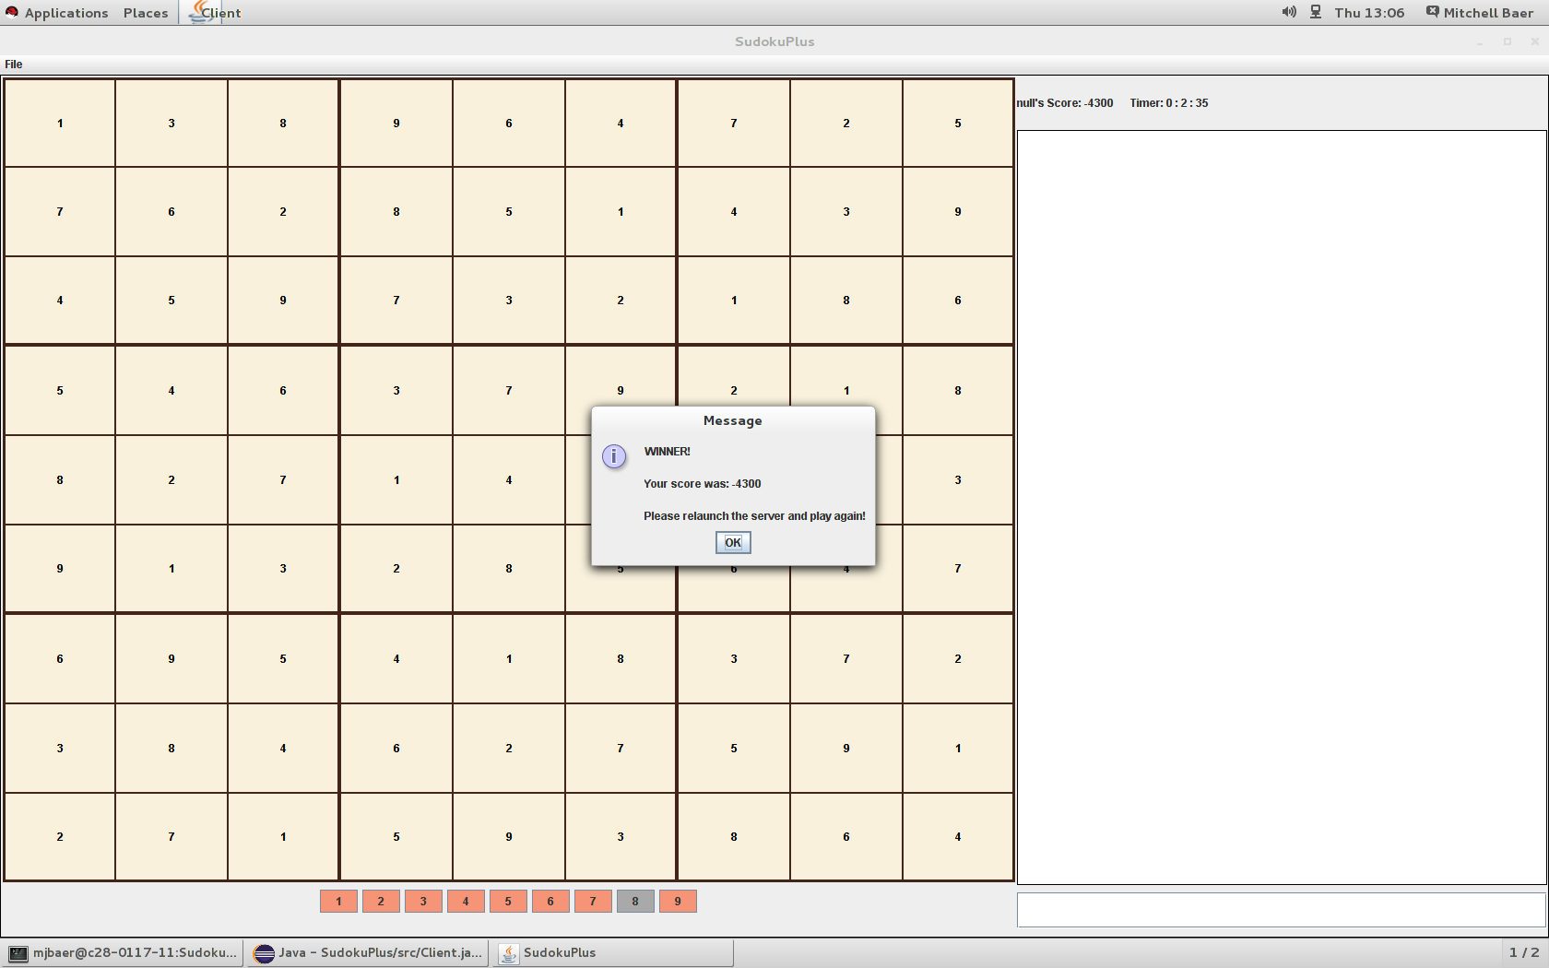

Slide 16
Final Burndown Chart

Slide 17
Difficulties Along The Way

Slide 18
Bugs

Slide 19
Cool Features

Slide 20
Finished Product Demo

Slide 21
Scrum

